Slide 1
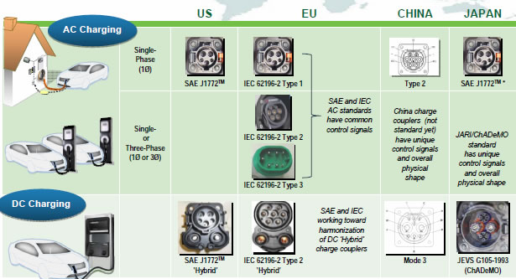

Slide 2
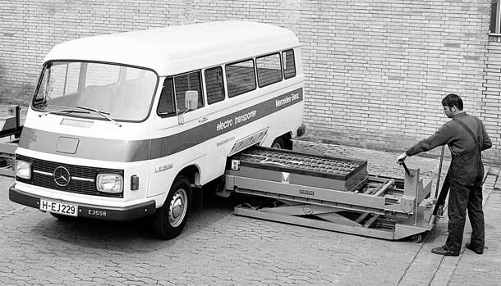
Fast: under 5 min.
The driver does not own the battery
battery life, maintenance, capital cost, quality, technology, and warranty to the battery switch station company.
The spare batteries at swap stations could participate in vehicle to grid storage

Slide 3
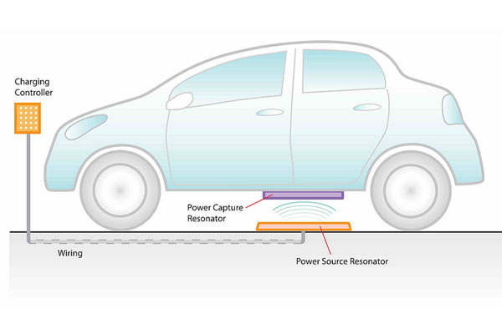

Slide 4
